Slide 1
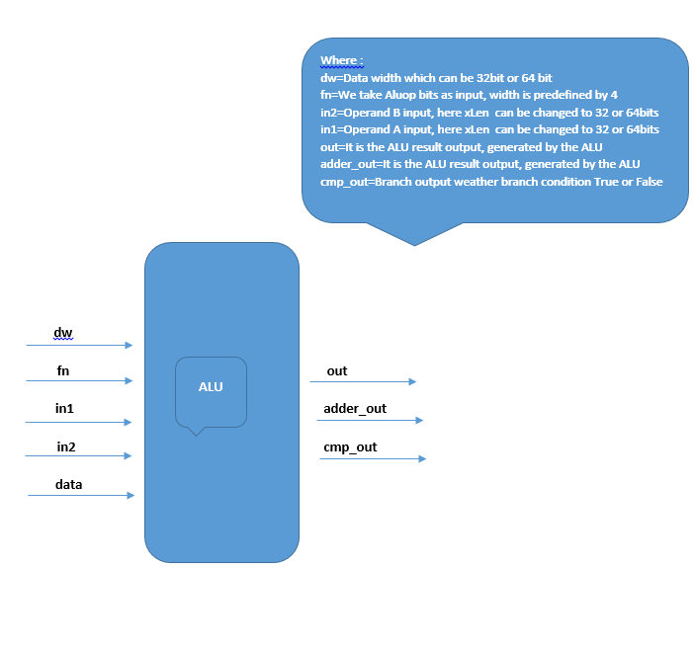

Slide 2
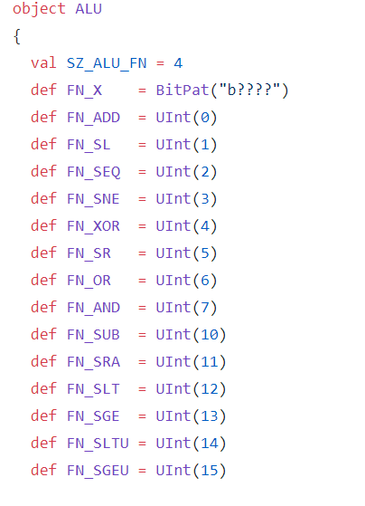
We created an object of ALU
We define variable (SZ_ALU_FN).This variable is Aluop bits which will decide what operation has to perform by ALU.
We define FN_X which uses BitPat command in order to enable representation of don't cares. We did not used this function in our code
We define functions of different operation which returns different unsigned integer values. We uses these unsigned integer values later in our code in order to compare Mux conditions
Functions | Operation function performs
FN_ADD | This function will perform Add operation
FN_SL | This function will perform Shift left operation
FN_SEQ | This function will perform Set equals to operation
FN_SNE | This function will perform Set not equals to operation
FN_XOR | This function will perform XOR operation
FN_SR | This function will perform shift right operation
FN_OR | This function will perform OR operation
FN_AND | This function will perform AND operation
FN_SUB | This function will perform subtraction operation
FN_SRA | This function will perform shift right arithmetic operation
FN_SLT | This function will perform set less than operation
FN_SGE | This function will perform set greater than operation
FN_SLTU | This function will perform Set less than unsigned operation
FN_SGEU | This function will perform Set greater than equals to unsigned operation

Slide 3
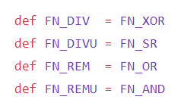
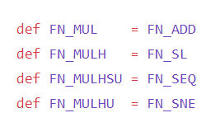
We define SZ_ALU_FN as 4 which means we have 2^4=16 possible ways in which we perform operations on ALU.This variable is defining our Aluop bits which in our case is 4.We can change a Aluop bits if we want to add more operations in our ALU
We define methods of M extension version of RISCV and these methods includes different methods of I format instruction of RSICV
Functions | Operation function performs
FN_DIV | This function will perform division operation
FN_DIVU | This function will perform division unsigned operation
FN_REM | This function will perform remainder operation
FN_REMU | This function will perform remainder unsigned operation
FN_MUL | This function will perform multiplication operation
FN_MULH | This function will perform multiplication higher bits operation
FN_MULHSU | This function will perform multiplication higher singed bits unsigned operation
FN_MULHU | This function will perform multiplication higher bits unsigned operation

Slide 4
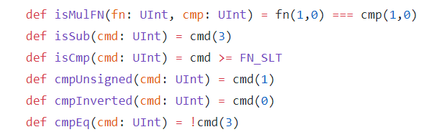
We define different methods to perform ALU operations isSub method used to perform subtraction operation isCmp and cmpUnsigned method is used to help in compare operations of ALU cmpEq(compare Equals) and cmpInverted(compare Inverted) method is used to check equality between operands of ALU
isMULFN takes two parameter fn and cmp as input where fn is ALUop bits and cmp is compare bits.

Slide 5
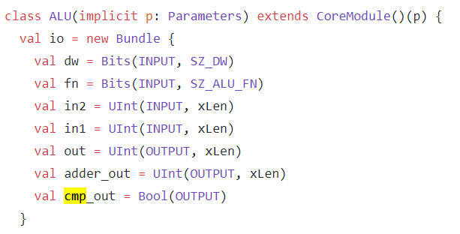
We create a class ALU and takes implicit parameter. Our class ALU is extend by main class Core Module
We have three inputs and three outputs
ALU I/O | Discription
dw | Data width which can be 32bit or 64 bit
fn | We take Aluop bits as input, width is predefined by 4
in2 | Operand B input, here xLen can be changed to 32 or 64bits
in1 | Operand A input, here xLen can be changed to 32 or 64bits
out | It is the ALU result output, generated by the ALU
adder_out | It is the ALU result output, generated by the ALU
cmp_out | Branch output weather branch condition True or False

Slide 6
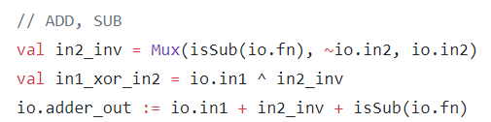
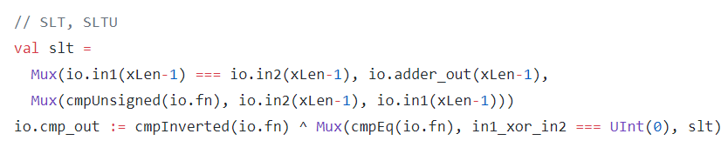
ADD &SUB SLT& SLTU
We create a variable val in2_inv which have MUX condition. Mux Condition has 1st parameter as Bool in which we have isSub method as input with fn as a parameter in it.If the condition true we get the complement output of ALU second operand input otherwise ALU second operand input will be selected as it is.
In the next step we take XOR operation between operand (in1) and in2_inv(MUX selection output)
We then add in1(operand A of ALU), in2_inv(MUX selection output) and Bool parameter of MUX .We than wired that result with wire adder_out
We created a variable slt to perform Set less than and set less than unsigned operation on ALU.We have our MUX in which we have Bool condition as parameter which describes if the width of the in1 and in2 are same after subtracting from each width we have true condition and width with subtraction of 1 would be wired with adder_out.
If our 1st MUX condition didn’t satisfy we have 2nd MUX in which we have function cmpUnsigned as input parameter of Bool with fn as its parameter if condition satisfies we select in2 with its width xlen -1 otherwise in1 will be selected with its width decrement by 1
We than use method cmpInverted and takes fn as parameter. We use MUX in order to compare operands and takes cmpEq as Bool parameter Mux input if condition satisfies we select xor result between in1 and in2 and compare it with UINT(0) if result is 0 it outputs 1 otherwise 0,thus if Mux condition did not satisfies slt will be selected and we than take XOR with the condition result of MUX with cmpInverted result

Slide 7
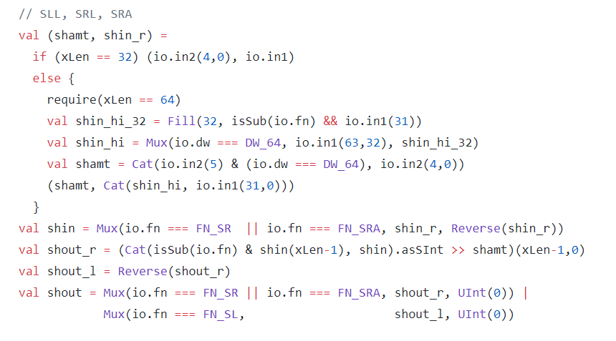
We create variables shamt and shin_r and assign them values using if condition.
If xLen is equals to 32 shamt will be equals to in2(operand B 5 bits) and shin_r is equals in1(operand A)
If xLen is not equals to 32 we have else condition and execute require method (if xlen is equals to 64)
We execute next line and create an immutable variable shin_hi_32(variable which fills 32 times weather with zeros or ones depending upon the AND condition)
We have created another variable shin_hi and uses Mux condition if dw (data width) equals to DW_64 in1 (63,32) bits will be extracted otherwise shin_hi_32 variable will be selected
We uses same variable name shamt and concatenate bits. Bits that will concatenate are the result of AND condition between in2 (operand B of ALU 5th bit) and data width condition of 64 bits and the other bits that will concatenate are in2(operand B bits from 0 to 4)
For shin_r we concatenate bits of shin_hi variable and in1(operand A of ALU) bits from 0 to 31
We uses shin variable Mux and takes fn comparison with FN_SR OR FN_SRA as Bool parameter if condition satisfies shin_r variable will be selected otherwise Reverse (shin_r) will be selected The reverse method will create a new sequence with the elements in reversed order
We create variable shout_r which concatenates bits and converts them to signed integer and then performs right shift operation with shamt variable
We have other variable shout_l which reverse the shout_r variable by using Reverse method
We uses shout variable which uses MUX and compare fn with FN_SR (shift right) OR fn with FN_SRA (shift right arithmetic) if condition of Mux satisfies shout_r variable selected
otherwise UInt(0) will be selected we then uses 2nd Mux which compares fn with FN_SL (shift left) if this condition satisfies shout_l will be selected otherwise UInt(0) will be chosen as output

Slide 8
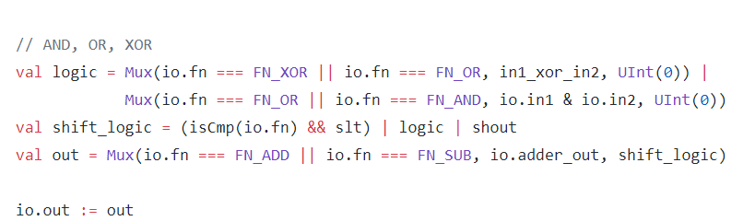
AND, OR, XOR
We have immutable variable logic, shift logic and out variable which we uses to calculate AND,OR and XOR operations in ALU.
We have logic variable in which we uses two Muxes and between them we perform OR operations.1st Mux has fn (ALUop) as Bool parameter if fn is equals to FN_XOR or fn is equals to FN_OR if this MUX condition satisfies we have XOR operation result between in1(operand A of ALU) and in2 (Operand B of ALU) as output otherwise UInt(0) will be selected if MUX Bool condition did not satisfies.
In logic variable we have 2nd Mux which has fn (ALUop) as Bool parameter if fn is equals to FN_OR or fn is equals to FN_AND we have AND operation result between in1(operand A of ALU) and in2 (Operand B of ALU) as output otherwise UInt(0) will be selected if MUX Bool condition did not satisfies.
We have shift logic variable which takes fn (ALUop bits) as input parameter of method isCmp and perform AND operation with slt variable .The result of AND condition will than perfrom OR bit operations with logic and shout variable
We have out variable in which we uses Mux in order to compare fn with FN_ADD and FN_SUB if condition of MUX sartisfies adder_out will be output from variable out otherwise shift_logic variable will be output
Variable out output is then wired with ALU out output

Slide 9
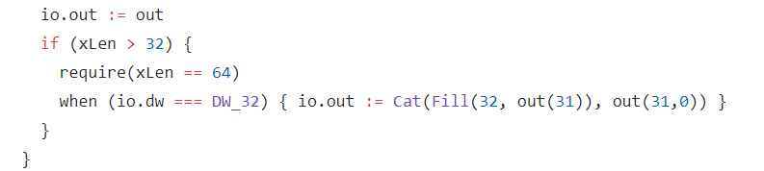
If xLen parameter is greater than 32 we execute if block and we have require statement which ensures that if xLen is equals to 64 rest of the code below will execute otherwise it will generate an exceptional error.
If require condition satisfies when condition will execute if dw (data width) is equals to 32we will concatenate bits and uses Fill command to make 64 bit output
Fill command used to replicate bits. In our case we uses 31th bit and Fill it by 32 times to make 64 bit output

